Slide 1
Edge Detection
N. Ravitha Rajalakshmi

Slide 2
Edge Detection
Find most relevant edges in the image.
These edges should be connected into meaningful lines and boundaries resulting in segmented image containing two (or) more regions.
The segmented results can be used for tasks such as object counting, feature extraction and classification.

Slide 3
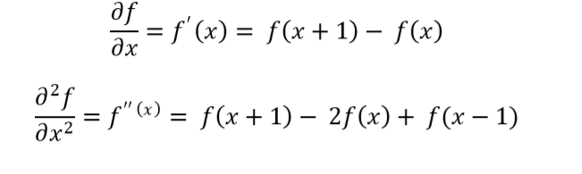
Basic Concepts
Edge represent boundary between two regions with different characteristics according to gray level, color (or) texture.
Derivatives can be a better operator to detect the points corresponding to edge
Given an one dimensional function f(x) , its first order and second order derivative can be expressed as the difference between two adjacent pixels.

Slide 4
Computing derivative in an image
Since derivative is a linear operator , it can be computed using masks
For example, the following mask can be used to determine the second order derivative
0 | 0 | 0
-1 | 2 | -1
0 | 0 | 0

Slide 5
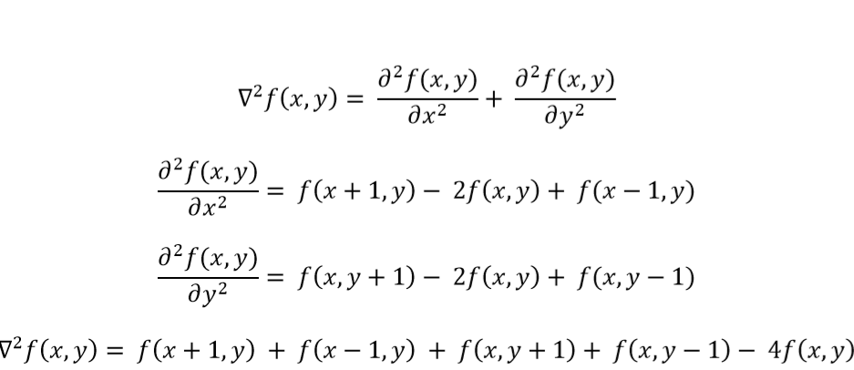
Detection of isolated point
Second order derivative is very sensitive to sudden changes
Hence, can be used to detect an isolated point
Laplacian operator provides the second order derivative over a two dimensional function

Slide 6
Contd..
0 | -1 | 0
-1 | 4 | -1
0 | -1 | 0
Decide a threshold T
In the resulting filter response, those pixels whose value is larger than T can be considered as an isolated point.

Slide 7
Line detection
Second order derivative can be used to detect lines
Another variant of Laplacian operator is shown below. It is isotropic, uniform in all directions.
Using Laplacian creates double edges
-1 | -1 | -1
-1 | 8 | -1
-1 | -1 | -1

Slide 8
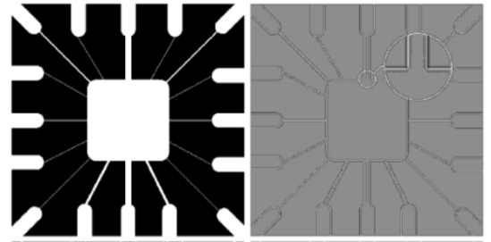
Double edge effect
Double edge effect is attributed to the
fact that second order derivates creates
two responses for every edge indicating the
Pixels that are occurring on the either side
of the edge pixel.
Original Image and Its Laplacian Response

Slide 9
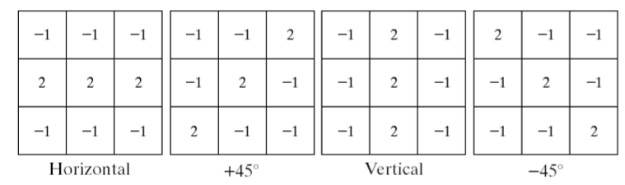
Line Masks
To detect lines in specific directions, use masks that would emphasize a certain direction and be less sensitive to other directions. Popular line masks are shown below

Slide 10
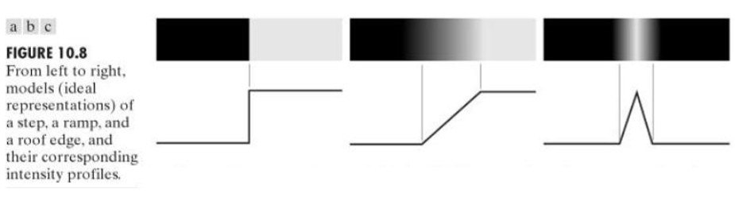
Edge Types
Three types of edge types which occurs in an image include
Step edge – Transition of intensity level is over 1 pixel only in ideal, or few pixels on a more practical use
Ramp edge – A slow and graduate transition
Roof edge – Transition is back and forth into varying intensity levels

Slide 11
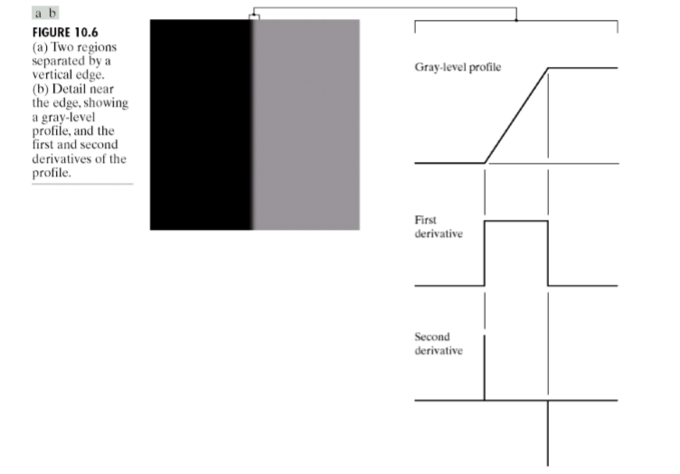
Edge Profile and its derivatives of ramp edge
First derivative
Magnitude can be used to detect the presence of edge at a certain point
Produces thick edges
Second derivative
Provide very strong response to fine details and noise
Sign determine whether edge pixel lie on the dark side (or) bright side.
Zero crossing between the negative and positive peaks of second order derivative can be used to detect the centre of thick edges

Slide 12
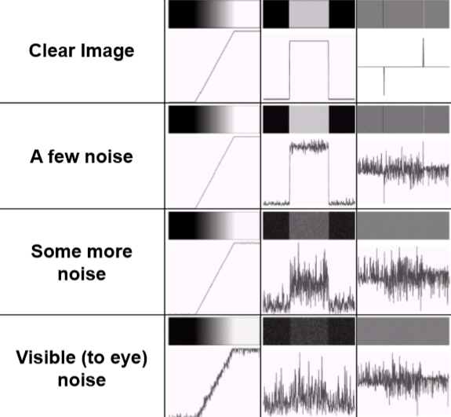
Edge Model Sensitivity
Edges are highly sensitive to noise.
Hence, it is a common practice to apply
noise reduction techniques before edge detection.

Slide 13
Basic Edge Detection Algorithm
It is a three stage process which involves
Smoothen the image for removing noise
Detect edge pixels
Combine them to form meaningful edge boundaries.

Slide 14
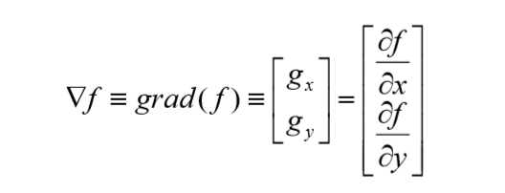

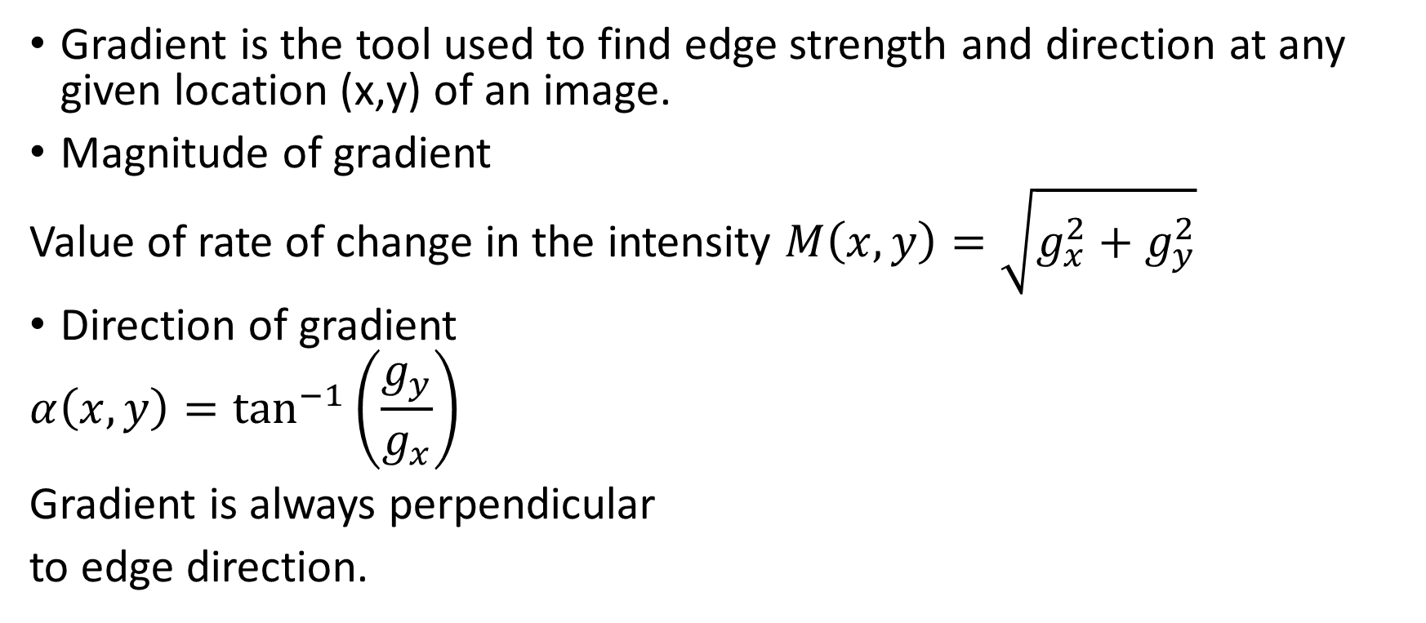
Edge Detection - Basics
Gradient is the tool used to find edge strength and direction at any given location (x,y) of an image.
Magnitude of gradient
Value of rate of change in the intensity $M\left(x,y\right)=\sqrt{g_{x}^{2}+g_{y}^{2}}$
Direction of gradient
$$α\left(x,y\right)=\tan^{−1}\left(\frac{g_{y}}{g_{x}}\right)$$
Gradient is always perpendicular
to edge direction.

Slide 15
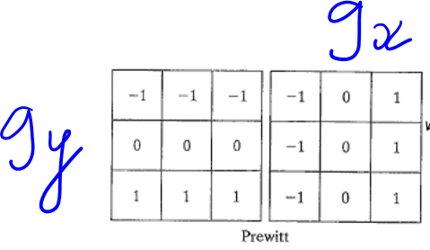
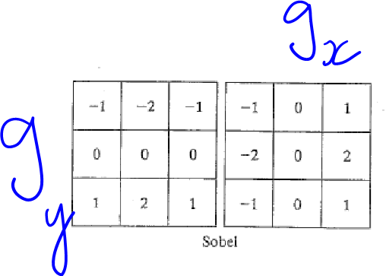
Prewitt and Sobel Operator
First order derivative operator centered around a pixel
It prevents the computation of the gradient at every pixel position via approximation over computation

Slide 16
Prewitt and Sobel Operator Characteristic
Both the operator mask coefficients sum to zero and also provide a response of zero in areas of constant intensity.
Sobel Provides noise suppression as it amplifies the center pixel values
Both filters are isotropic (provides uniform result across horizontal and vertical edges.)

Slide 17


Advanced Edge Detectors
Marr-Hildreth
Intensity changes are not independent of image scale
Hence the detector must be tuned to any scale
Used an operator Laplacian of Gaussian
Gaussian Operator
Laplacian of Gaussian Operator

Slide 18
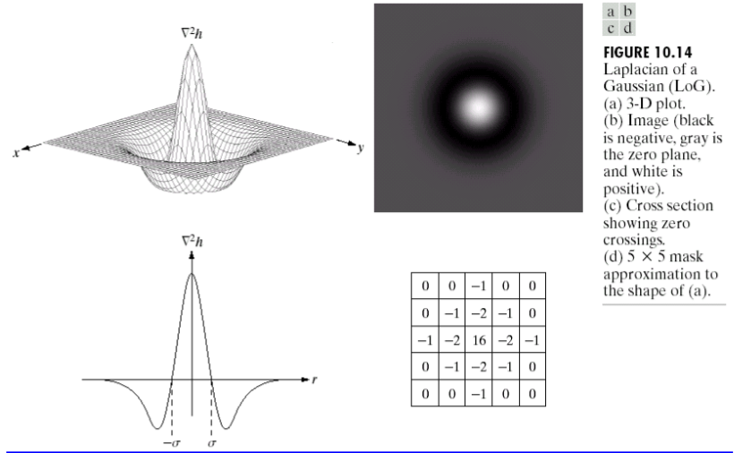
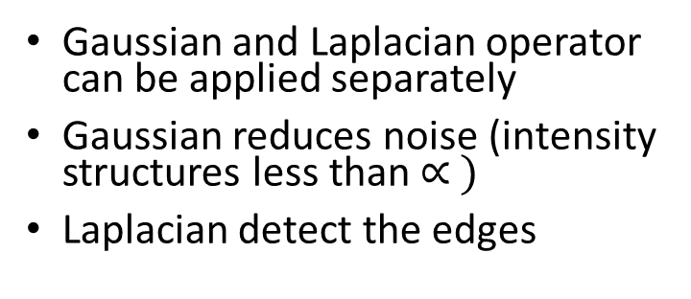
Contd..
Gaussian and Laplacian operator can be applied separately
Gaussian reduces noise (intensity structures less than $∝ )$
Laplacian detect the edges
Generic Algorithm:
Filter image using Gaussian
Detect edges using Laplacian
Find zero crossings to detect the center of the edge

Slide 19
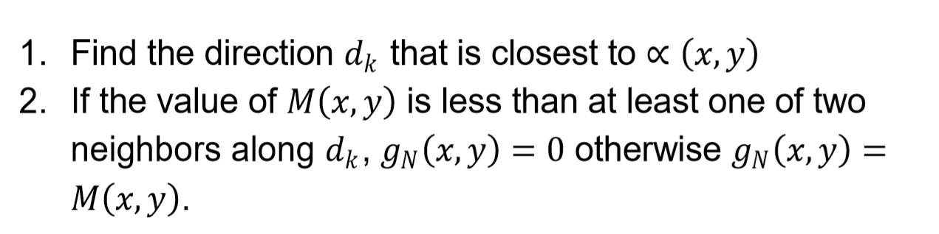
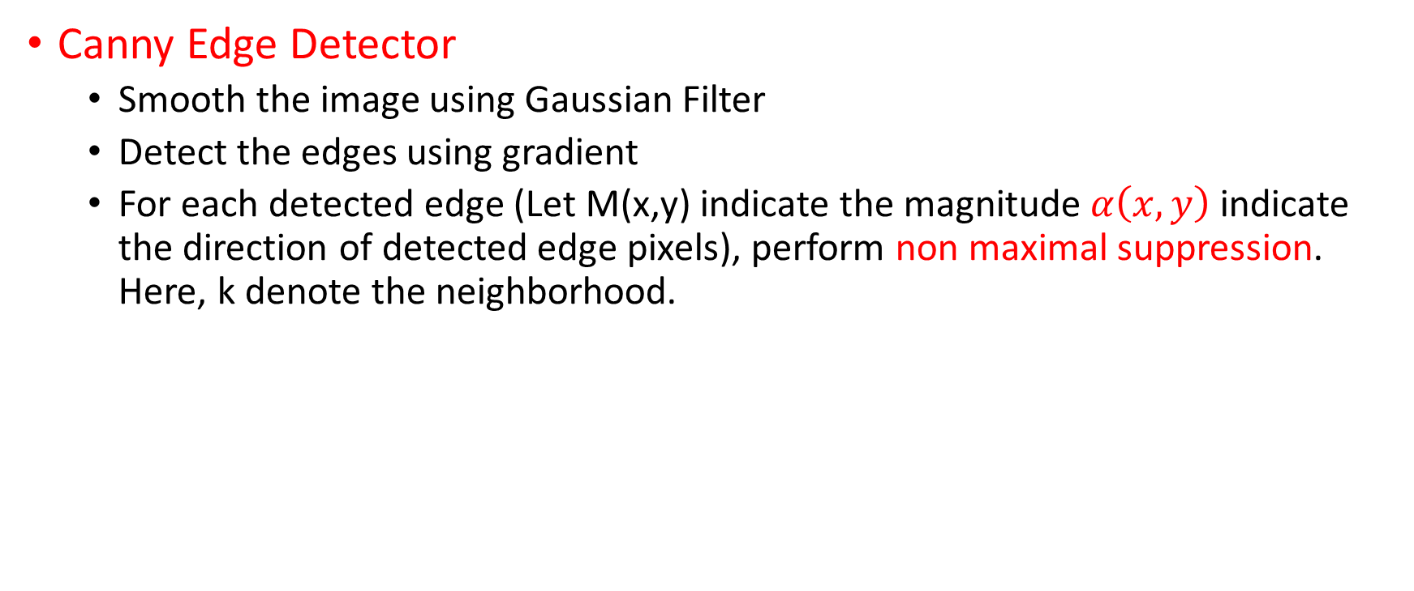
Advanced Edge Detectors
Canny Edge Detector
Smooth the image using Gaussian Filter
Detect the edges using gradient
For each detected edge (Let M(x,y) indicate the magnitude $α\left(x,y\right)$ indicate the direction of detected edge pixels), perform non maximal suppression. Here, k denote the neighborhood.

Slide 20
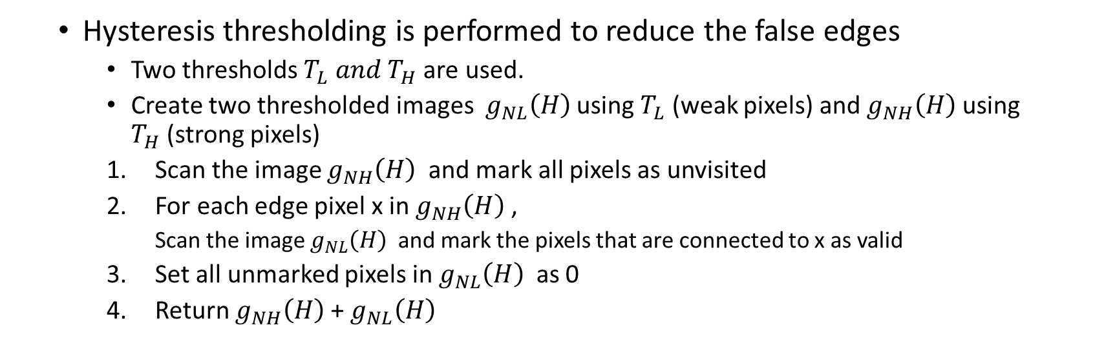
Contd..
Hysteresis thresholding is performed to reduce the false edges
Two thresholds $T_{L} and T_{H}$are used.
Create two thresholded images $g_{NL}\left(H\right)$using $T_{L}$ (weak pixels) and $g_{NH}\left(H\right)$ using $T_{H}$(strong pixels)
Scan the image $g_{NH}\left(H\right)$ and mark all pixels as unvisited
For each edge pixel x in $g_{NH}\left(H\right)$ ,
Scan the image $g_{NL}\left(H\right)$ and mark the pixels that are connected to x as valid
Set all unmarked pixels in $g_{NL}\left(H\right)$ as 0
Return $g_{NH}\left(H\right)$ + $g_{NL}\left(H\right)$
Those weak pixels that are connected to strong pixels are considered as edge pixels

Slide 21
Edge Linking
These edge pixels from previous module result in fragmented edges.
So the method is usually followed by linking algorithm designed to assemble edge pixels into meaningful edges.
Two methods include
Local Processing
Pixels which are similar according to predefined criteria are linked.
Global Processing (Hough Transform)
Detect all pixels that lie on particular shape

Slide 22
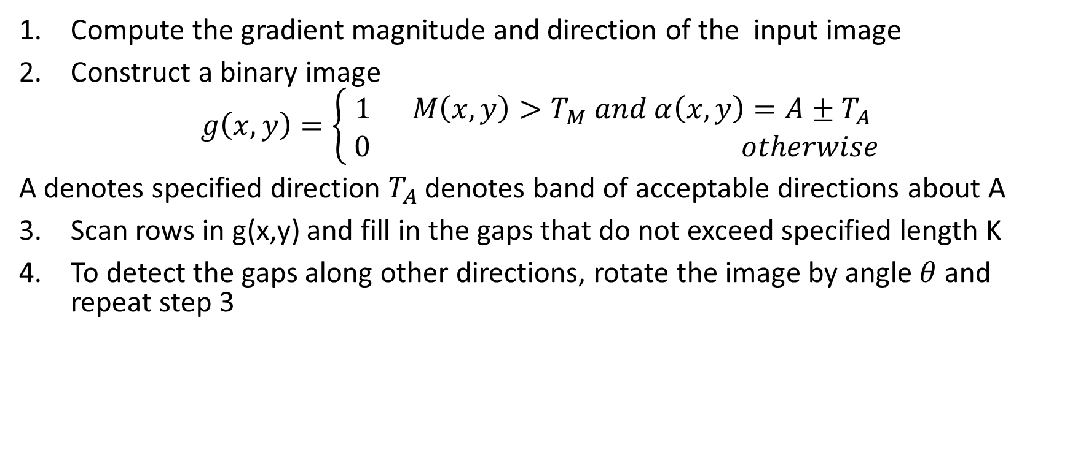
Local Processing – Edge Linking
Compute the gradient magnitude and direction of the input image
Construct a binary image
$$g\left(x,y\right)=\left\{\begin{aligned}1 M\left(x,y\right)>T_{M} and α\left(x,y\right)=A±T_{A} \\ \begin{matrix}\end{matrix}0 otherwise\end{aligned}\right.$$
A denotes specified direction $T_{A}$ denotes band of acceptable directions about A
Scan rows in g(x,y) and fill in the gaps that do not exceed specified length K
To detect the gaps along other directions, rotate the image by angle $θ$and repeat step 3

Slide 23







Global Processing – Edge Linking
Given that pixels lie on a straight line, it can be detected using Hough Transform
It utilizes parameter space for detection of line from the available edge pixels
Provided that (x1,y1) and (x2,y2) are edge pixels, there is inherently a line connecting them which needs to be detected by Hough transform
$$\left(x_{1},y_{1}\right)$$
$$y$$
$$\left(x_{2},y_{2}\right)$$
$$x$$

Slide 24





x1,y1
Parameter space
Line equation can be expressed as
Y = a x + b
Here a and b corresponds to parameter space, they determine the slope and intercept of a line in the cartesian plane
In a deterministic parameter space, check whether the (x,y) passes through the line specified by a and b. There are multiple values of (a, b) denoting set of lines in which (x,y) passes through
If there are two edge pixels say (x1,y1) and (x2,y2) lie on the same line in cartesian plane, then they intersect in parameter space at some point
b
$$b^{′}$$
$$a^{′}$$
x2,y2
a
$a^{′}$ and $b^{′}$ indicate the slope and intercept of the line on which the point (x1,y1) and (x2,y2) passes through in the cartesian plane

Slide 25
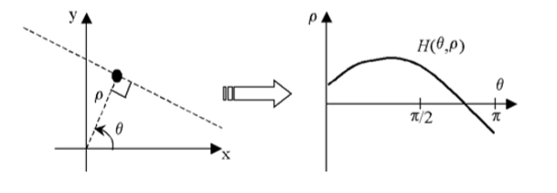
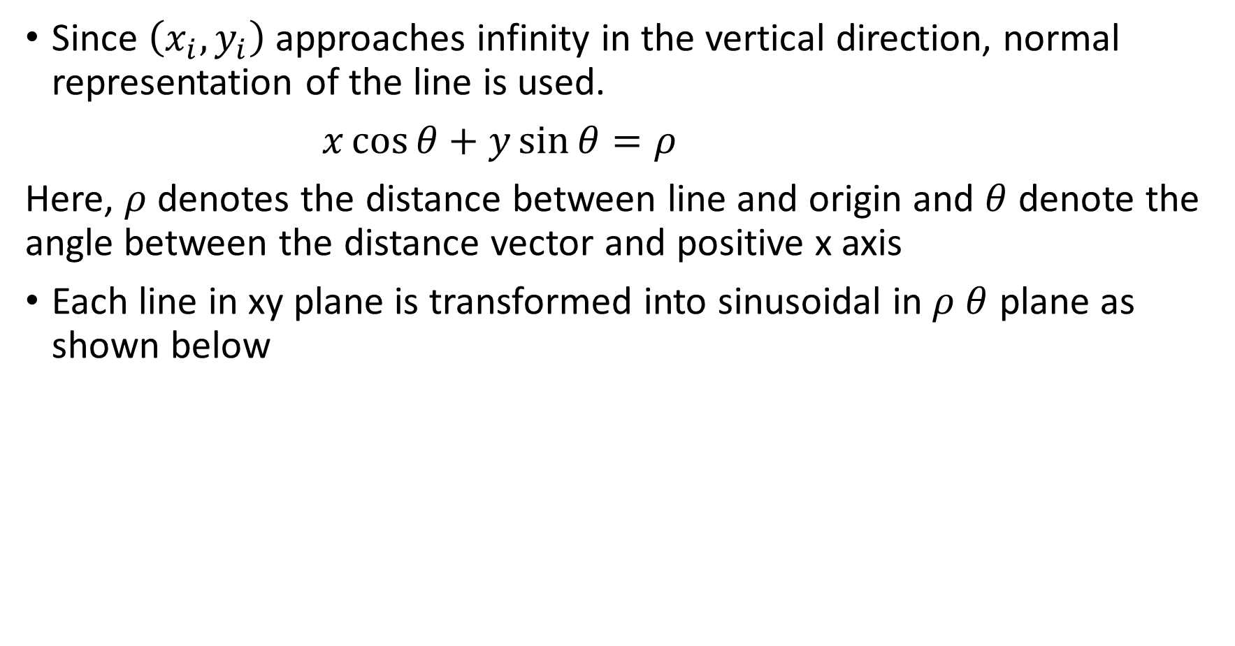
Since $\left(x_{i},y_{i}\right)$ approaches infinity in the vertical direction, normal representation of the line is used.
$x\cos{θ}+y\sin{θ}=ρ$
Here, $ρ$ denotes the distance between line and origin and $θ$ denote the angle between the distance vector and positive x axis
Each line in xy plane is transformed into sinusoidal in $ρ$ $θ$ plane as shown below

Slide 26
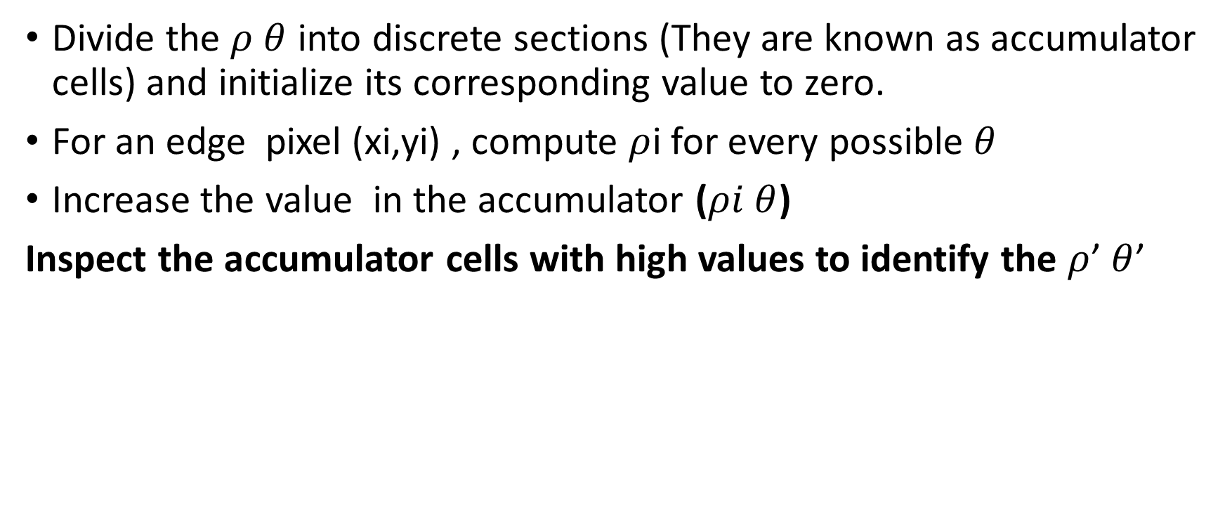
Hough Transform Implementation
Divide the $ρ$ $θ$ into discrete sections (They are known as accumulator cells) and initialize its corresponding value to zero.
For an edge pixel (xi,yi) , compute $ρ$i for every possible $θ$
Increase the value in the accumulator ($ρi$ $θ$)
Inspect the accumulator cells with high values to identify the $ρ$’ $θ$’

